Slide 1
ICCAD-2017 Problem A: Resource-aware Patch Generation
Ching-Yi Huang, Chih-Jen Hsu, Chi-An Wu, ⁺Kei-Yong Khoo
Cadence Taiwan, Inc., ⁺ Cadence Design System, Inc.
Nov-13, ICCAD
Notes:
Hello everyone, My name is Ching-Yi Huang from Cadence Taiwan.
I’m the topic chair of problem A of CAD Contest this year.
The title of problem A is Resource-aware …

Slide 2
Outline
Introduction
Problem Description
Problem Formulation
Program Requirement
Evaluation Method
Benchmark Suites
Contest Results
Notes:
Here is my outline today.
I will quickly introduce our problem, formulation and evaluation.
And present the benchmark we used for this problem.
Finally, before announcing the winners. I’ll show some contest results between teams from alpha test to the final results

Slide 3
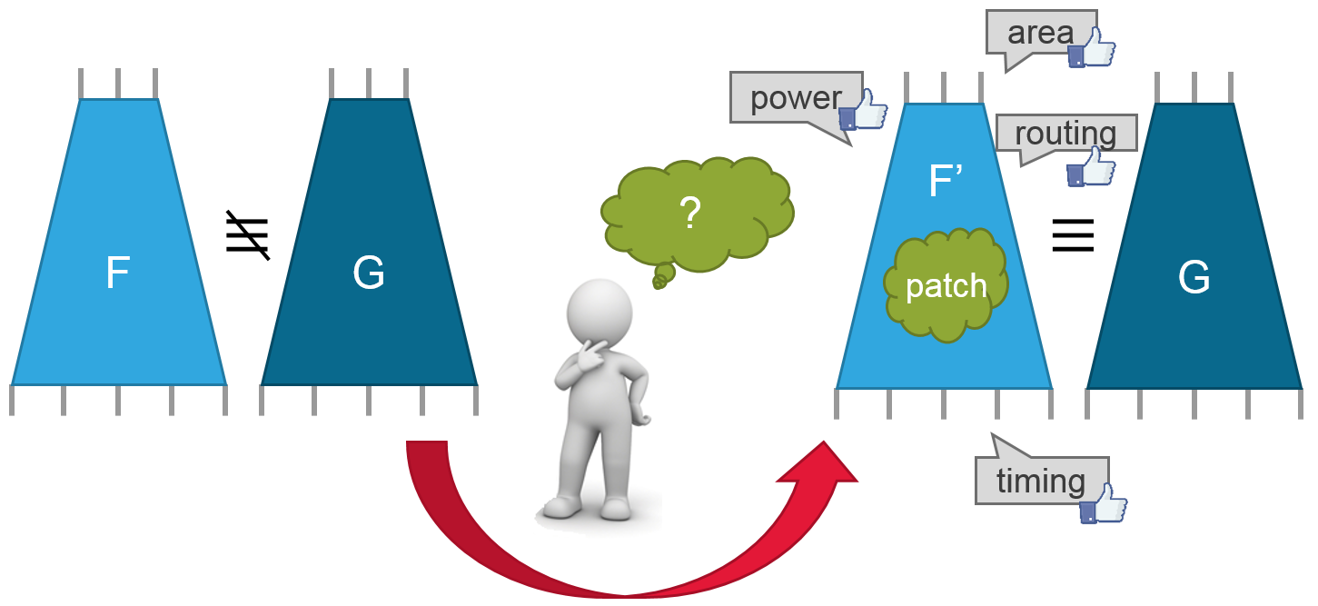
Introduction
An automated Engineering Change Order (ECO) process identifies the differences between the old circuit F and the new circuit G, and generate a corresponding patch function such that F’ and G become equivalent
With a functional ECO problem, the quality of patch plays an important role in the performance of the patched circuit.
The resource-aware patch generation problem
Notes:
We know that aECO is a process that ..
In this problem …

Slide 4
Introduction
In this contest, contestants need to generate patch functions that will make two circuits equivalent, while minimizing the resource cost of the generated patches.
Resource cost is the comprehensive physical cost of all the patches, and minimizing the resource cost implies improving patch quality (timing, power, routing, or area).
The resource-aware patch generation problem
Notes:
In this contest, …
The resource cost here is …

Slide 5
Introduction
We have assigned each internal node a reasonable constant weight to represent the corresponding physical cost if the node is used for generating patches.
Also, the resource cost of the patches is calculated as the weight summation of patches’ support nodes.
This formulation can elegantly identify wanted algorithms for the resource-aware patch generation problem.
The resource-aware patch generation problem
Notes:
We …
Also …
This formulation can …

Slide 6
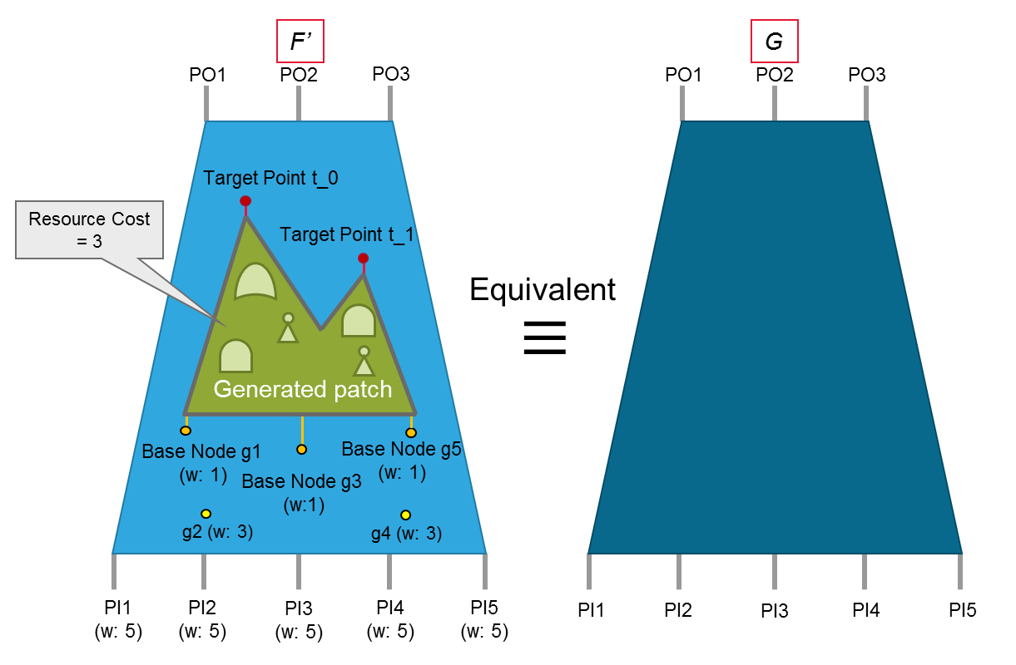
Problem Formulation
Given two circuits F and G, and the weight information of internal nodes in F, contestants need to utilize internal nodes in F as supports, called base nodes, to generate the patch functions with minimum resource cost at a specific set of target points in F such that F’, the patched circuit, and G are equivalent. The resource cost is calculated by the weight summation of the used based nodes.
Notes:
This is the problem formulation …

Slide 7
Example
Unit 1
Output
F.v | weight.txt
module top (y1, y2, a, b, c); input a, b, c; output y1, y2; wire g1, g2, g3; wire t_0; and (g1, a, b); xor (g2, a, c); nor (g3, b, c); and (y1, g1, g2); or (y2, t_0, g3); endmodule | a 5 b 5 c 5 g1 2 g2 2 g3 1 y1 1
G.v
module top (y1, y2, a, b, c); input a, b, c; output y1, y2; wire g1, g2, g3, g4; not (g1, c); and (g2, a, g1); nor (g3, a, b); and (g4, b, c); and (y1, b, g2); or (y2, g2, g3, g4); endmodule
patch.v | out.v
module patch (y, a, b); input a, b; output y; or (y, a, b); endmodule | module top (y1, y2, a, b, c); input a, b, c; output y1, y2; wire g1, g2, g3; wire t_0; and (g1, a, b); xor (g2, a, c); nor (g3, b, c); and (y1, g1, g2); or (y2, t_0, g3); patch p0 (.y(t_0),.a(g1),.b(g2)); endmodule
Notes:
Here is an example of the problem
Given F.v weight.txt, we can see that there is a floating wire t_0
Contest needs to generate a patch function at t_0 and make out.v with patch.v be eq to G.v

Slide 8
Program Requirement
Run on a Linux system.
Time limit of running each testcase is 1800 seconds.
Parallel computation with multiple threads or processes is not allowed.
Must follow the output format.
Notes:
Here is our requirement.
More details can be seen on the website

Slide 9
Evaluation Method
1. Correctness: Must follow the output format and the patched circuit must be equivalent to <G.v>. Any violation gets score of 0 for that testcase.
2. Time limit: For each testcase, the program must output files within 1800 seconds; otherwise, the team gets score of 0 for that testcase.
3. Scoring according to the rank: The teams get their scores by their ranks for that testcase. The teams with the rank 1~6 will get scores of {10, 7, 5, 4, 3, 2}, respectively. The remaining teams get a score of 1. Teams are ranked based on the following criteria
a. We rank teams according to the resource cost. The smaller is better.
b. If the resource cost ties, we rank the teams by the patch size. The smaller is better.
c. If teams still tie, we rank them according to the runtime. The less is better.
The team earning the highest accumulated scores for all the benchmarks wins the contest.
Notes:
We give score for testcase. And the team earning the higheset ….
For each testcase, as mentioned, contestants must follow … , otherwise…
Must have output files and we evaluated the files, otherwise…
The score is determined according to the rank of a team for a testcase. ….
Then, how we rank??
Based on the following criteria
The resource cost is the most important, the smaller is better.
If it ties, then we compare the ..
If it still ties, …

Slide 10
Example
Team | Resource Cost | Patch Size | Runtime | Rank | Score
A | 4 | 1 | 10 sec. | 1 | 10
B | 4 | 4 | 5 sec. | 2 | 7
C | 4 | 4 | 8 sec. | 3 | 5
D | 12 | 3 | 1 sec. | 4 | 4
E | 12 | 3 | 2 sec. | 5 | 3
F | 12 | 4 | 20 sec. | 6 | 2
G | 15 | 1 | 3 sec. | 7 | 1
H | 100 | 20 | 1800 sec. | 8 | 1
I | No Valid Output | No Valid Output | 1800 sec. | N/A | 0
Notes:
Here is an example of ranking and scoring.
A, B, C have the smaller

Slide 11
Benchmark Suites
In this contest, we provide benchmarks that are representatives of industrial problems with several ECO scenarios.
We created the benchmark suites from ISCAS, ITC99 in IWLS 2005 benchmarks, OpenCore, LGSynth'93, and some datapath parts from complex industrial designs.
We considered different ECO scenarios, different numbers of fix points, different fix points’ distances to primary inputs/primary output, and different problem sizes.
Weight distribution:
T1: Distance-aware distribution – A.
T2: Distance-aware distribution – B.
T3: Path-aware distribution.
T4: Locality-aware distribution.
T5: The distribution composed of T1 + T3.
T6: The distribution composed of T2 + T3.
T7: The distribution composed of T1 + T4.
T8: Highly mixed and undulating distribution
Notes:
In this …
From these open source benchmarks
When createing …
The final weight distributions of considered ECO scenarios including these eight types …

Slide 12
Benchmark Suites
A half of single-fix problems and a half of multiple-fix problems.
14 open cases and 6 hidden cases.
Different types of weight distribution are also evenly distributed to the benchmarks
Information of the benchmark suite
 | # of Target Points
Distribution | 1 | 2 | 4 | 8 | 12
T1 | u1, u3, u7, u12 |  |  | (u17)
T2 | (u15) | u5, u10
T3 | u8 |  | u9
T4 | u4, (u18) |  |  | u11
T5 (T1 + T3) | u13
T6 (T2 + T3) |  |  |  |  | u14
T7 (T1 + T4) |  |  | (u19)
T8 | u2 | u6, (u16) | (u20)
*Hidden cases are in bracket symbol.
Notes:
And final test, totally we prepare 20 cases.
A half…
14 …
This table summarizes the information of the benchmark suite, which can be found in the proceeding.

Slide 13
Contest Results
Problem difficulty analysis
Alpha Test
 | unit1 | unit2 | unit3 | unit4 | unit5 | unit6 | unit7 | unit8 | unit9 | unit10 | unit11 | unit12
#Success | 9/11 | 5/11 | 5/11 | 7/11 | 3/11 | 1/11 | 4/11 | 5/11 | 2/11 | 1/11 | 1/11 | 5/11
Avg.Time | 3.92 | 15.17 | 32.4 | 5.52 | 709.2 | 1740 | 335.5 | 197.4 | 254.6 | 1739 | 1739 | 202.2
Beta Test
 | unit1 | unit2 | unit3 | unit4 | unit5 | unit6 | unit7 | unit8 | unit9 | unit10 | unit11 | unit12 | unit13 | unit14
#Success | 15/15 | 11/15 | 11/15 | 11/15 | 7/15 | 7/15 | 10/15 | 10/15 | 7/15 | 6/15 | 5/15 | 10/15 | 11/15 | 6/15
Avg.Time | 40.32 | 16.17 | 32.4 | 25.13 | 501.9 | 1001 | 378.3 | 256.3 | 91.39 | 891.4 | 994.3 | 141.4 | 6.58 | 373.7
Final Test
 | unit1 | unit2 | unit3 | unit4 | unit5 | unit6 | unit7 | unit8 | unit9 | unit10 | unit11 | unit12 | unit13 | unit14
#Success | 13/14 | 12/14 | 12/14 | 12/14 | 11/14 | 11/14 | 12/14 | 12/14 | 12/14 | 10/14 | 8/14 | 12/14 | 12/14 | 12/14
Avg.Time | 1.36 | 202.2 | 24.47 | 3.4 | 262.6 | 867.5 | 472.0 | 258.5 | 144.1 | 522.5 | 552.1 | 140.5 | 264.3 | 604.4
 | unit15 | unit16 | unit17 | unit18 | unit19 | unit20
#Success | 12/14 | 12/14 | 10/14 | 11/14 | 7/14 | 9/14
Avg.Time | 199.0 | 335.3 | 191.3 | 428.6 | 1238 | 270.7
Notes:
OK, now I’ll show some interesting results from alpha test to the final test.
These tables show how many teams successfully generated a valid result for a testcase and the average time to deal with a testcase
We can see that for the alpha test, many teams cannot generate valid results for almost all testcases.
Thus, obviously, these released testcases are not trivial cases.
However, we can see their program become mature in beta test.
More teams can generate valid testcases.
We can also see that their algorithm may not efficient enough to solve some cases of large problem-size.
I think the difficuity diversity is not bad.
In the final test, tell the truth
It’s impressive that many teams have much better results.
Many teams can genereate valid results for most all testcases.
The time cost is also further reduced.
Later we can also see the final result of teams also prove that the benchmark can identify the capability of algorithms .

Slide 14
Contest Results
Average score of Top 5 for Alpha Test
Many teams have format issues
Final ???
Final ???
Final ???
Notes:
This bar chart illustrate the …
The colored bar represent the average score of the final top 3
We can see not 1 of them is the first place of the alpha test, and two of them are not in top3
BTW, in alpha test,
Many teams have format issues
But I still give the evaluation scores for reference

Slide 15
Contest Results
Average score of Top 5 for Beta Test
Still many teams have format issues
Final ???
Final ???
?
?
Notes:
And in the beta test
The ranks of final top3 are even worse.
Here I don’t use the colors because they know their ranks when beta test.
However, this time, the average score of top5 is quite close.
I believe some teams started to improve the algorithm, and they have hard competition for the released benchmarks.
Also, in beta test, there are still many format problems.

Slide 16
Contest Results
Average score of Top 5 for Final Test (without hidden cases)
Final ???
Final ???
Final ???
Notes:
In the final test, without hidden cases.
Top 3, come back!
But this is the result without hidden cases.
Let’s guess whether the rank will be changed when including the hidden cases

Slide 17
Contest Results
Average score of Top 5 for Final Test (with hidden cases)
Final 1st
Final 2nd
Final 3rd
Notes:
So, this is the final result
The yellow one is the final 1 place
The blue one is the third , …
But when including …

Slide 18
Contest Results
Final Top 5 score distribution
Notes:
Let’s see the score discribution
We can see that yellow obtain really many rank 1 for testcases
But not every testcase.
For some testase, the blue one or the green one acturally have better results then the yellow one.
We can also see that the blue one averagely gains 7 points for testcases
The green one gain some 10 points but they also gets some 0 points.

Slide 19
Detailed Result
Final 1st
Testcase | Unit1 | Unit2 | Unit3 | Unit4 | Unit5 | Unit6 | Unit7 | Unit8 | Unit9 | Unit10 | Unit11 | Unit12 | unit13 | unit14 | unit15 | unit16 | unit17 | unit18 | unit19 | unit20 | Total
Elapsed Time | 0.17 | 0.62 | 0.17 | 0.17 | 16.43 | 112.3 | 4.33 | 3.89 | 1.17 | 52.68 | 543.29 | 0.52 | 0.57 | 12.64 | 1.53 | 17.57 | 2.33 | 6.49 | 217.4 | 0.77
Resource Cost | 4 | 17 | 80 | 42 | 47 | 5660 | 284 | 78 | 50 | 135 | 4142 | 104 | 3467 | 95 | 191 | 318 | 434 | 18 | 501804 | 136
Patch Size | 1 | 4 | 3 | 5 | 30 | 6605 | 2 | 4 | 29 | 587 | 1063 | 1 | 9 | 42 | 11 | 13 | 79 | 1 | 7686 | 6
Score | 10 | 10 | 7 | 1 | 10 | 1 | 10 | 7 | 10 | 4 | 2 | 10 | 1 | 7 | 3 | 2 | 10 | 10 | 3 | 5 | 123
Final 2nd
Testcase | Unit1 | Unit2 | Unit3 | Unit4 | Unit5 | Unit6 | Unit7 | Unit8 | Unit9 | Unit10 | Unit11 | Unit12 | unit13 | unit14 | unit15 | unit16 | unit17 | unit18 | unit19 | unit20 | Total
Elapsed Time | 0.17 | 2.08 | 0.32 | 0.22 | 13.5 | 36.29 | 9.73 | 39.29 | 8.18 | 9.84 | 229 | 1.12 | 6.83 | 74.07 | 3.53 | 5.63 | 20.6 | 58.2 | N/A | 16.25
Resource Cost | 4 | 17 | 80 | 36 | 47 | 118 | 284 | 80 | 50 | 135 | 760 | 104 | 3833 | 104 | 168 | 260 | 436 | 106 | N/A | 120
Patch Size | 1 | 5 | 3 | 2 | 49 | 5 | 2 | 5 | 50 | 310 | 369 | 1 | 12 | 65 | 5 | 13 | 101 | 21 | N/A | 6
Score | 10 | 3 | 5 | 1 | 7 | 7 | 5 | 1 | 5 | 5 | 10 | 7 | 1 | 1 | 7 | 7 | 7 | 2 | 0 | 7 | 98
Final 3rd
Testcase | Unit1 | Unit2 | Unit3 | Unit4 | Unit5 | Unit6 | Unit7 | Unit8 | Unit9 | Unit10 | Unit11 | Unit12 | unit13 | unit14 | unit15 | unit16 | unit17 | unit18 | unit19 | unit20 | Total
Elapsed Time | 0.27 | 8.49 | 1.28 | 0.22 | N/A | 1144.2 | 9.3 | 203.16 | 673.03 | 219.19 | N/A | 15.52 | 3.28 | 52.12 | 2.29 | 31.29 | N/A | 16.14 | N/A | 126.18
Resource Cost | 4 | 17 | 80 | 32 | N/A | 118 | 284 | 78 | 86 | 135 | N/A | 104 | 2656 | 501 | 168 | 262 | N/A | 18 | N/A | 168
Patch Size | 1 | 4 | 3 | 1 | N/A | 5 | 2 | 4 | 55 | 243 | N/A | 1 | 16 | 49 | 2 | 11 | N/A | 1 | N/A | 11
Score | 10 | 4 | 4 | 10 | 0 | 5 | 7 | 4 | 1 | 10 | 0 | 3 | 10 | 1 | 10 | 5 | 0 | 7 | 0 | 3 | 94
Notes:
These tables show the details of their results
The third place really have some great results but unfortunaly did not generate valid results for four testcases.
The second place did a great job.
The first place team generate valid results for every testcase. And gets much scores compared to the second and 3rd one, excellent.

Slide 20
Top 3 Teams
Notes:
Now let’s see who are the top 3 teams

Slide 21
The 3rd Place
Team cada047 : depag
Japan
The University of Tokyo
Members: Yusuke Kimura, Peikun Wang, Yukio Miyasaka, Kentaro Iwata, Xingming Le, Xiaoran Han
Advisors: Prof. Amir Masoud Gharehbaghi and Prof. Masahiro Fujita

Slide 22
The 2nd Place
Team cada081: Hilbert
Taiwan
National Taiwan University
Member: He-Teng Zhang
Advisor: Prof. Jie-Hong Roland Jiang

Slide 23
The 1st Place
Team cada020 : CCU EDA Resyn
Taiwan
National Chung Cheng University
Member: Ai-Quoc Dao
Advisors: Prof. Mark Po-Hung Lin and Dr. Alan Mishchenko

Slide 24
THE END
THANKS FOR PARTICIPATION

Slide 25
Contest Results
Average score of top 5 for Beta Test

